Slide 1
Deep Snake for Real-Time Instance Segmentation
Sida Peng, Wen Jiang, Huaijin Pi, Hujun Bao, Xiaowei Zhou
Zhejiang University
Dongze Lian
2020-02-28

Slide 2
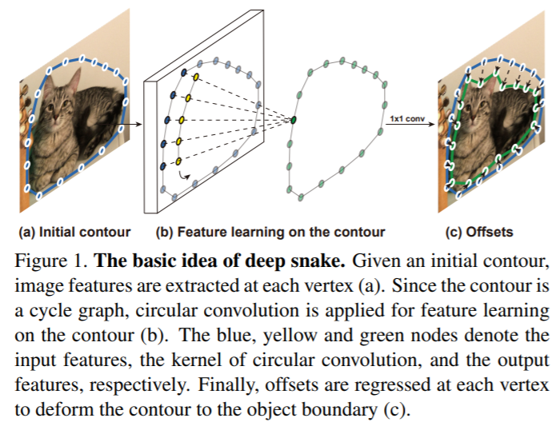
Basic idea of deep snake

Slide 3
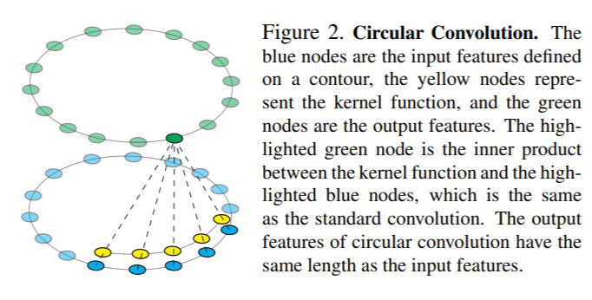


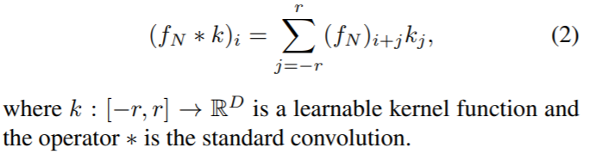

Circular Convolution
Input: contour
N vertices
For a vertex $x_{i}$:
The input dimension:
$\left(D+2\right)×N$
Output: contour (offset)
Circular Convolution

Slide 4
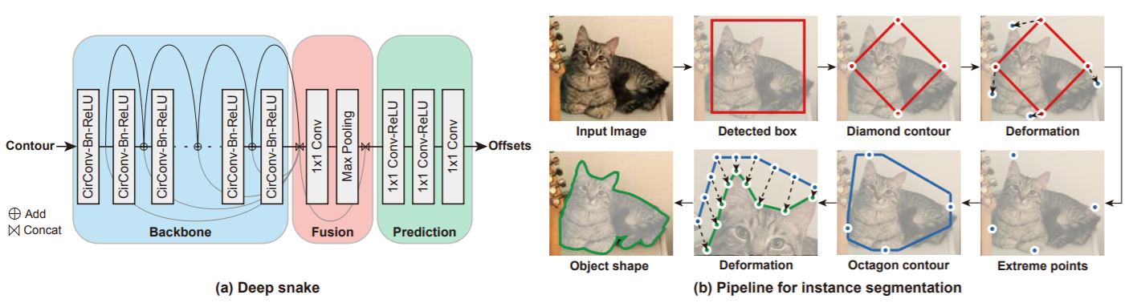
Network architecture
Initial contour proposal: extreme points
The number of vertices: N=128, uniformly
Long range points: iteratively

Slide 5
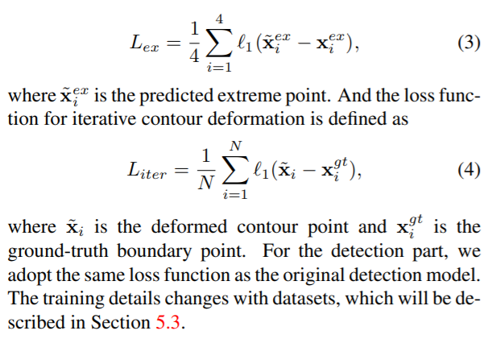
Loss function

Slide 6
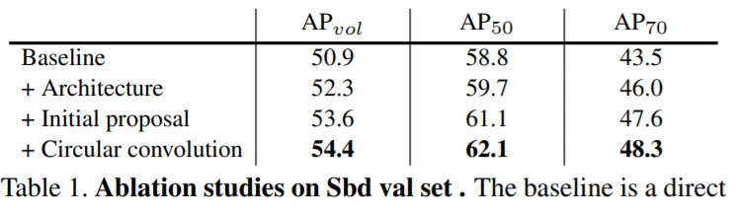
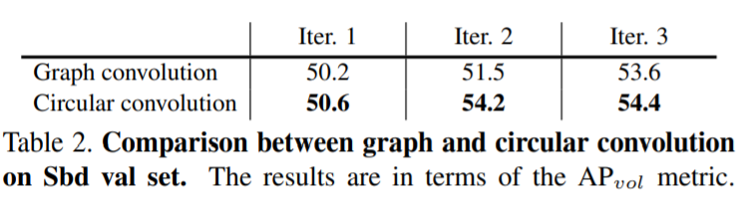
Experiments
Ablation study

Slide 7
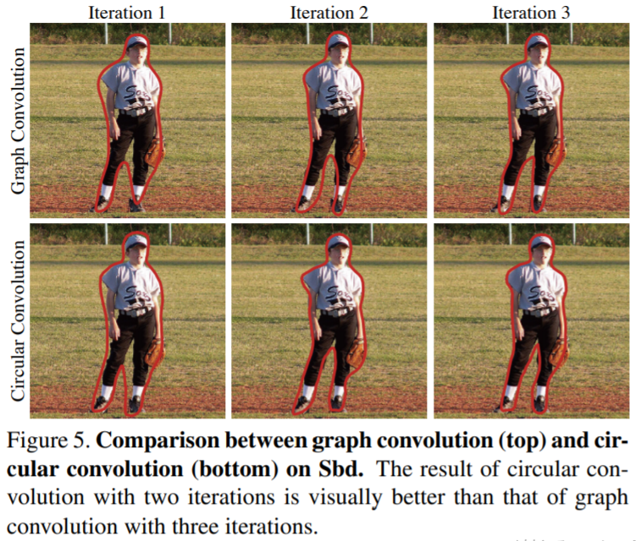
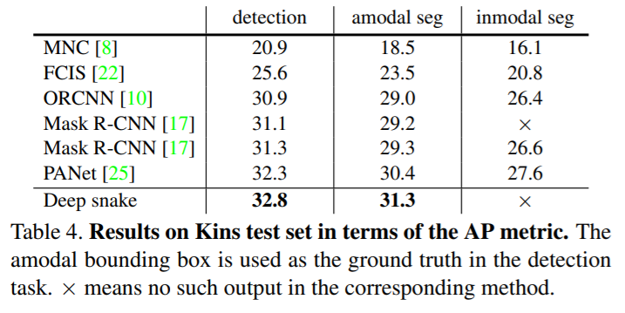
Experiments

Slide 8
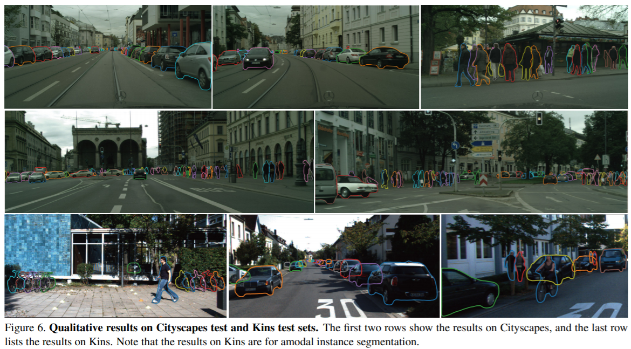
Experiments

